Slide 1
CSE 2102: Introduction to Software Engineering
Object-Oriented Paradigm

Slide 2
Object-oriented paradigm
Object-oriented decomposition:
  Decompose the problem into Agents which perform operations.
  Emphasize Agents that cause actions.
Agents comprised of two parts:
  Hidden implementation: Data and operations only available to Agent.
  Public interface: Operations available to the clients of agent.
An Agent can only be modified by operations defined in either the hidden implementation or public interface.

Slide 3
Core object oriented concepts
Class
  The Type of an Agent
  Describes the behavior
Object
  The Instance of a class
  Represents actual data manipulated by Agents
  Maintains the state of the object
Method
  Operation defined on a class
  Operates on All Instances of the class
Message
  Indicates that the object’s method is invoked.

Slide 4
Class
occurrences
roles
things
organizational units
places
external entities
structures
class name
A class is a generalized description of
a collection of similar objects.
Object is an instance of a class.
Class exports:
-Operations used to manipulate instances
-May export attributes.
attributes:
operations:

Slide 5
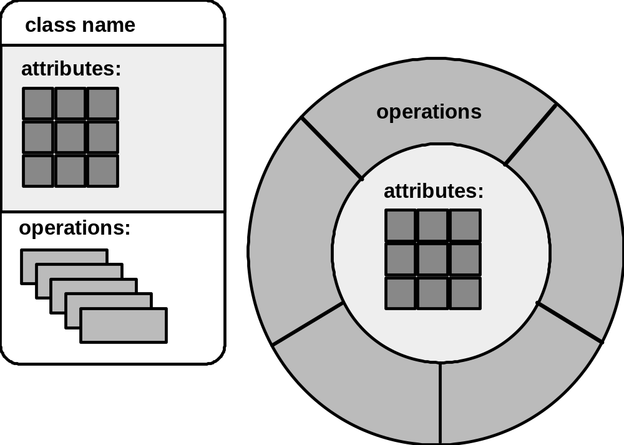
Two representations of a class

Slide 6
Operations (or methods or services)
An executable procedure that is a part of a
class and operates on the data attributes
defined as part of the class.
A method operates on all instances of a class
A method is invoked via message passing.

Slide 7
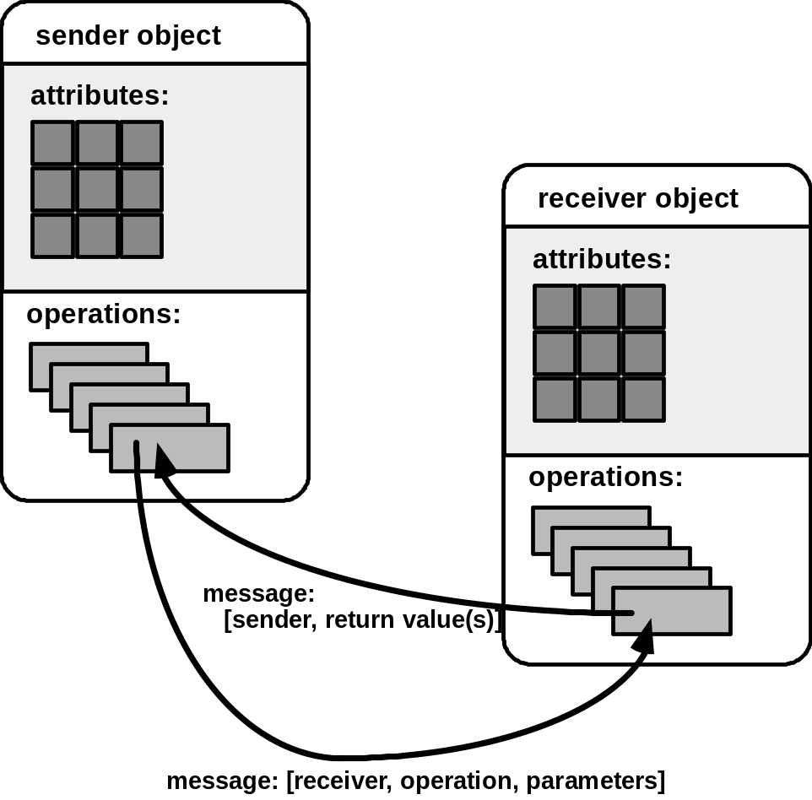
Messages
Messages - the means by which objects invoke each other’s methods.

Slide 8
An example Employee class
Class Employee
{
}
Main()
{
//Declare Objects
Employee emp1(Steve,100.0);
Employee emp2(Lois, 120.0);
//Pass Messages
//Invoke Methods
emp1.print_name();
emp1.print_salary();
emp2.update_salary(10);
emp2.print_name();
emp2.print_salary();
}
//Hidden Implementation
Private: //Instance Vars
char[30] name;
float salary;
//Public Interface
Public:
void print_name();
void print_salary();
void update_salary(float i);
Employee(char *n, float s);
What’s Output of Main()?
Conclusion:
Each Object (emp1,emp2) has
Own Independent State that
is Accessible via Shared
Public Interface of Class
Steve
100.0
Lois
130.0

Slide 9
Categories of classes
Data Managers: Maintain data/state information
Contain functionality for application
class Item {
private: // Private Data
int UPC;
char* Name;
int InStock, OnShelf, ROLimit;
float RetailCost;
public: // Public Methods
Item(int code, char* str, int st1,
int st2, int st3, float cost);
void CreateNewItem();
int GetUPC();
char* GetName();
int GetQuantity();
int CheckReorderStatus();
void PrintItem();
void UpdatePrice(float new_value);
};

Slide 10
Categories of classes (contd..)
Data Container class – stores objects of other (data manager) classes
class ItemDB
{private:
int Num_Items;
int Curr_Item;
Item* AllItems[Max_Items];
int FindFirstItem();
int FindNextItem();
int FindItemUPC(int code);
int FindItemName(char* name);
public:
ItemDB(); // Constructor
void InsertNewItem(Item* new_one);
void DeleteExistingItem(int code);
void FindDisplayItemUPC(int code);
void FindDisplayItemName(char* name);
void PrintAllItems();
};

Slide 11
Categories of classes (contd..)
Data Manager class
Item class contains the state of a
single object
Item I1, I2, I3;
Data Container class
ItemDB is a collection or set of items
Item ItemDB[100];
I1
“milk”
I2
“peas”
I3
“soda”
ItemDB

Slide 12
Categories of classes (contd..)
Viewer/Observer: Provide an interface for user
- Often collects information via public interface of multiple classes
- InvControlGUI utilizes Item ItemDB etc.
class InvControlGUI
{ private:
int Curr_Option; // Current menu option
public:
InvControl(); // Constructor
void PrintMenuSetOption();
void ActivateController();
void EnterNewItem();
void RemoveExistingItem();
void FindItem();
void InvSearchQuantity();
void InvSearchReorder();
void GenerateAnOrder();
};

Slide 13
Categories of classes (contd..)
Data sink class:
  Classes that consume data – output file, port
Data source class:
  Classes that generate data – random number generators fibonacci sequence.
Facilitator/Helper – Used to support complex tasks
  E.g. GUI libs, Strings, I/O Handler etc.
  Data structures classes.
  Standard, well-known algorithms/functions such as sorters, parsers.

Slide 14
How to find classes

Slide 15

How to find classes (contd..)

Slide 16
Inheritance: Motivation
Person Faculty: Person Dean:Person
Name Rank School
SSN Dept. Dept.
Years Years
Undergrad: Person Grad: Person
Dorm Dorm
Year Program
GPA Degree
GPA
Person
Faculty Dean Undergrad Grad

Slide 17
Inheritance: Motivation
Consider a software application written for a university
Four types of individuals and their attributes have been identified
To successfully utilize inheritance:
  Distinguish differences (Specialization)
  Identify commonalities (Generalization)

Slide 18
Inheritance: Motivation
Person
Name
SSN
Employee Student
Dept. Dorm
Yrs. GPA
Faculty Dean Undergrad Grad
Rank School Year Program
Degree
Solution utilizes single inheritance
Exactly one parent for each class
Are we done?

Slide 19
Inheritance: Motivation
Person
Name
SSN
Employee Student
Dept. Dorm
Yrs. GPA
Faculty Dean Undergrad Grad
Rank School Year Program
Degree
Superclass, supertype, parent, base class
Subclass, subtype, child, derived class
Descendants, ancestors, siblings

Slide 20
Inheritance: Definition
Subclass acquires information and/or operations of a superclass
Inheritance is a transitive operation:
  Behavior and information flows down the ancestral chain.
  A => B => C, then C acquires information & methods from both A and B.
Behavior and information of a subclass is a superset of its ancestors
Generalization and specialization:
  Subclass is more refined than superclass – its specialized
  Superclass contains common characteristics of its subclasses – its generalized

Slide 21
Inheritance: Definition
Inheritance may be used when two or more classes are functionally and/or informationally related.
University example, common data is the basis of inheritance.
Other basis for inheritance could be:
  Common methods
  Common data and methods
Inheritiance facilitates reuse from both informational and functional perspective
  Information – No replicated variables
  Function – No replicated methods/code

Slide 22
Benefits of inheritance
Software reusability
  Inherited characteristics often represents compiled and tested code/behavior
  Reuse in future products
  Design and program families
Design and code sharing
  Two or more subclasses of the same superclass share code.
  Redundancy is reduced
  Reliability/testing enhanced
  Inherit from existing subclass that has been utilized and exercised

Slide 23
Benefits of inheritance (contd..)
Software components
  Promotes the concept of reusable software components and software factory
  Combine/Assemble rather than construct
  JavaBeans and APIs, Ada95 packages etc.
Rapid prototyping
  Utilization of reusable components
  Incremental design and development
  Delivery of multiple prototypes
  Faster to market
All benefits apply to design, development and maintenance

Slide 24
Costs of inheritance
Execution speed
  Compile-time overhead due to inheritance
  Many decisions related to inheritance must occur at runtime.
Program size
  Libraries are large, and only if static linking is allowed size grows
  Dynamic linking techniques may be improving
  Improve runtime environment
Platform independence (Java) impacts both speed and size.

Slide 25
Costs of inheritance (contd..)
Message passing overhead:
  An overuse of messages is equivalent to an overuse of procedures/functions in C or Pascal.
  Messages that pass arrays increase overhead
  To find the “correct” method, must search object, parent, grandparent, etc.
  Remote messages for distributed object computing (CORBA, Java RMI)
Program complexity
  For any new paradigm, software engineers must acquire appropriate skills
  Despite the growing power of hardware, software size and complexity continues to grow

